Slide 1

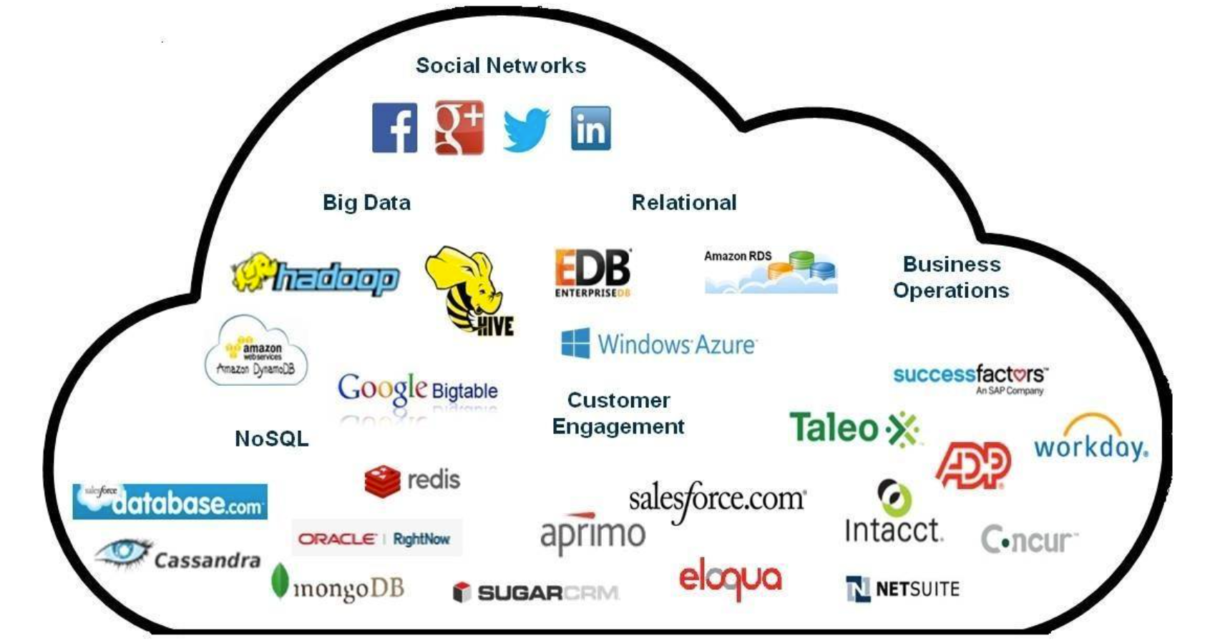
Build Your Successful Data Career Path
——From 5000 Job Postings in Indeed
Army-Ants :
Yangxi Yu
Xiaohan Sun
Shuyan Yue
Zonghao Li
Chen Tang
Liming Pang

Slide 2
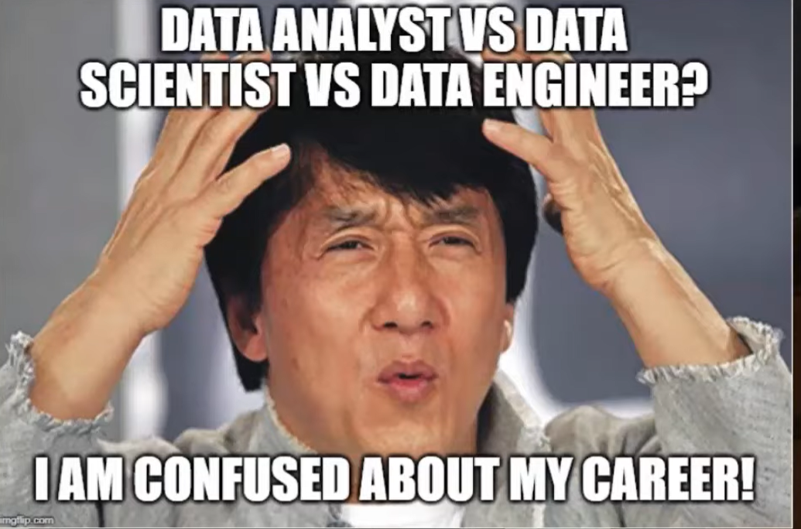
GOALS
What is difference between data analyst and data scientist and data engineer?
How is job market of data science?
What should we prepare for eligible data-relevant positions?

Slide 3
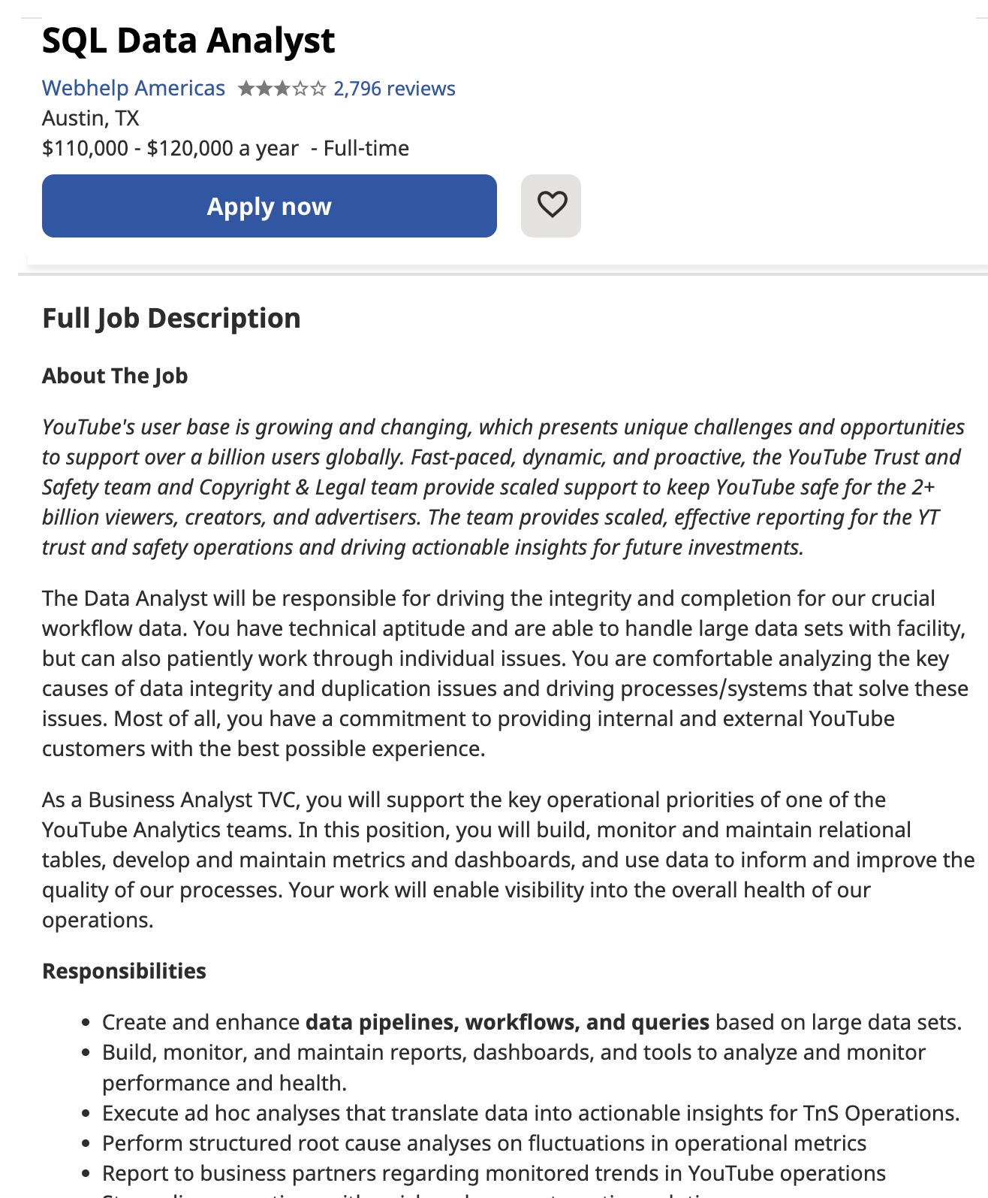
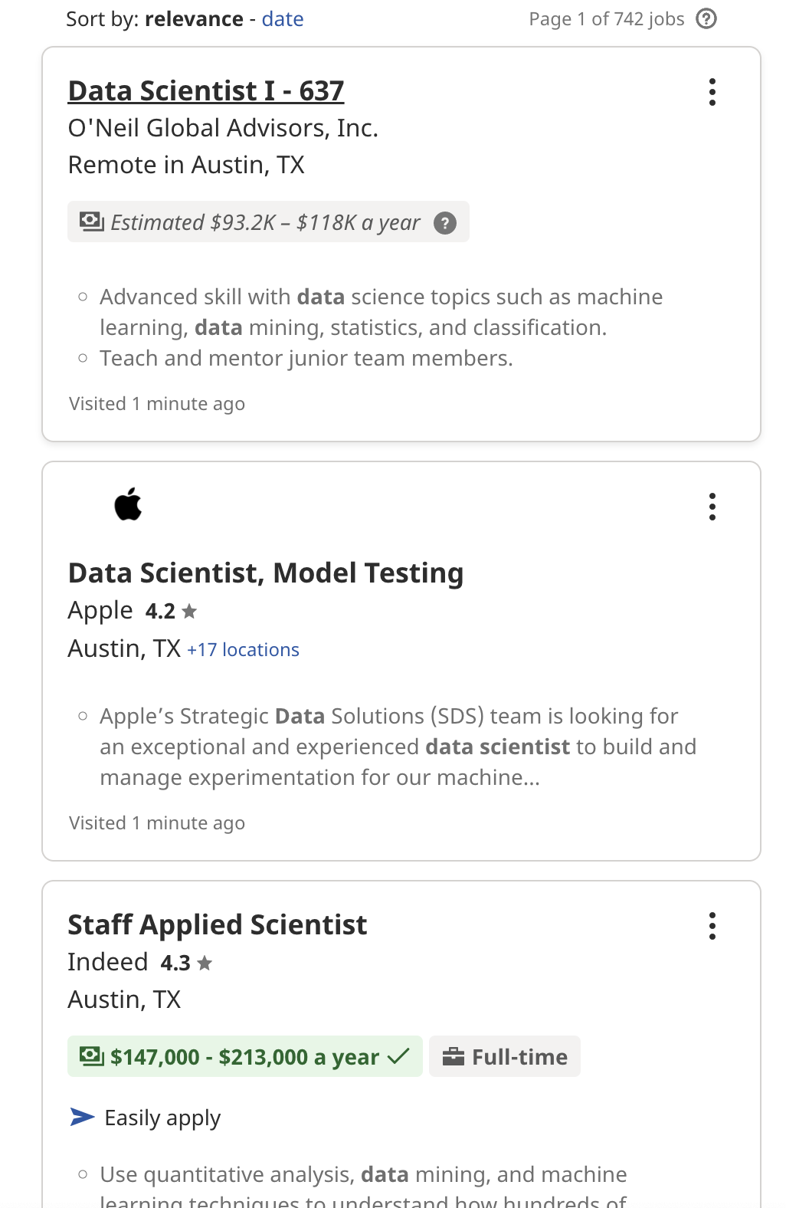
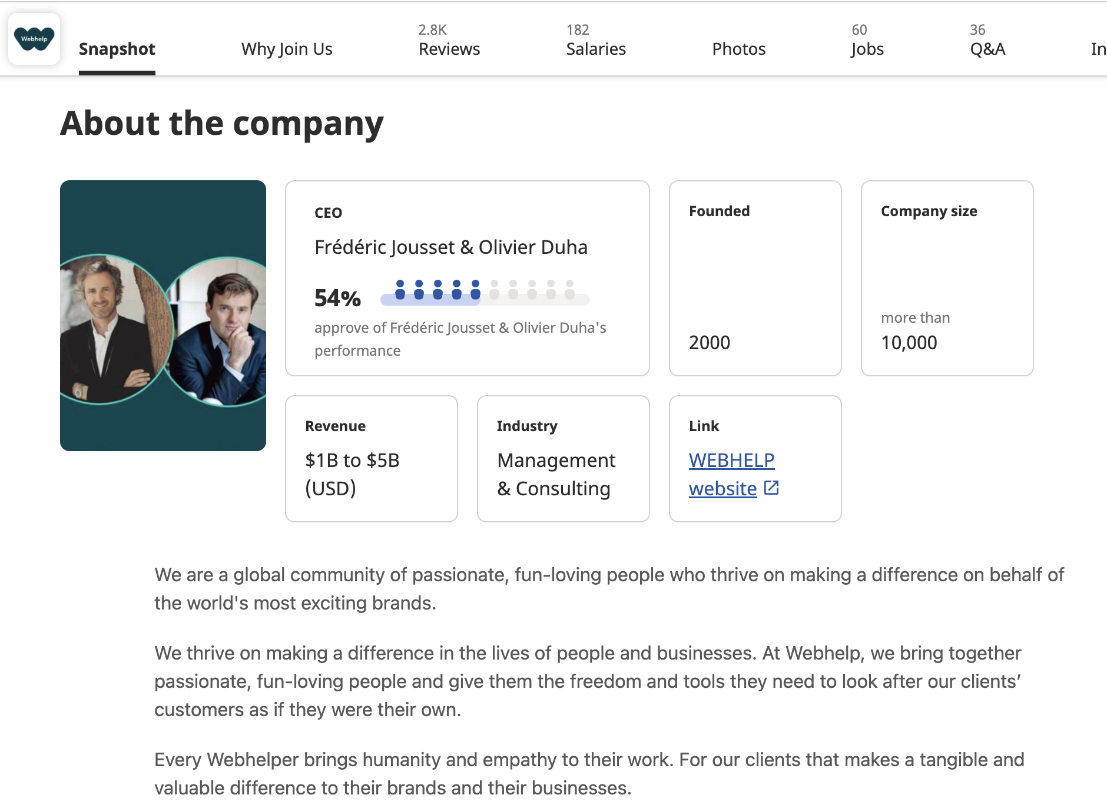
Methodology
STEP
Indeed Website
Raw Data
Cleaned Data
Analysis
Finding
Job list
job_list_html.csv
job_basic_info.csv
Key Delivery
Job Description
Chats & Grids
Reports
Company Info
job_desc_html.csv
job_desc_info.csv

Slide 4
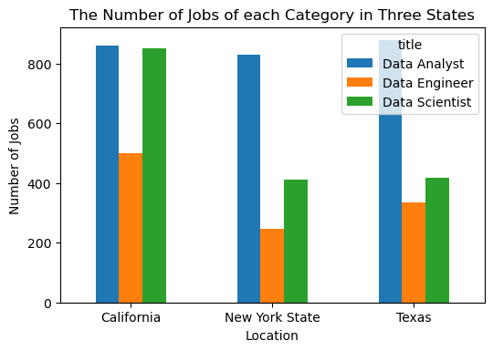
Job Market -- Job-Postings
Generally:
Data-related jobs are in great demand in recent days(5000 job postings), especially data analyst.

Slide 5
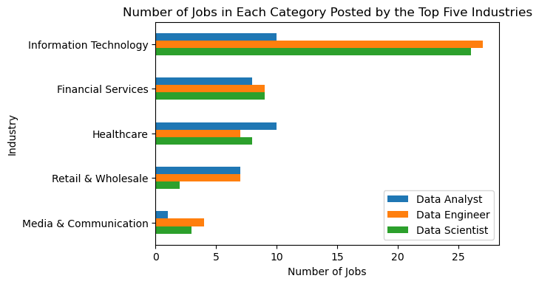
Job Market -- Industry
Data Analyst Mainly distributes in Financial Services, Healthcare, Retail, Wholesale, and IT Sector
Data Engineer and Data Scientist Concentrate on IT Sector

Slide 6
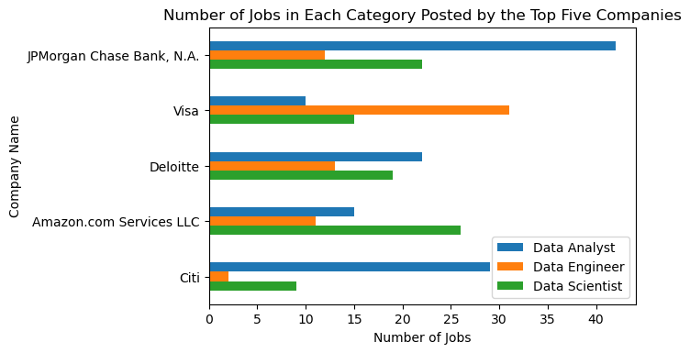
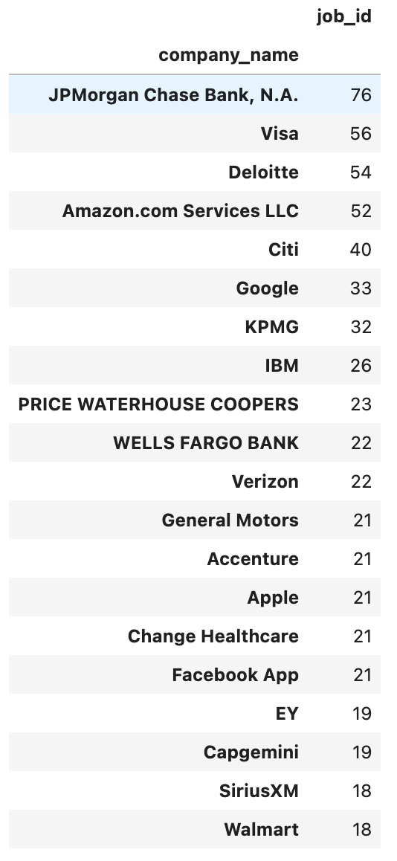
Job Market -- Company
Top 20
Companies
Financial Giant companies are in great need for candidates with data-skills.
JP Morgan -- Data Analyst
Visa -- Data Engineer
Amazon -- Data Scientist

Slide 7
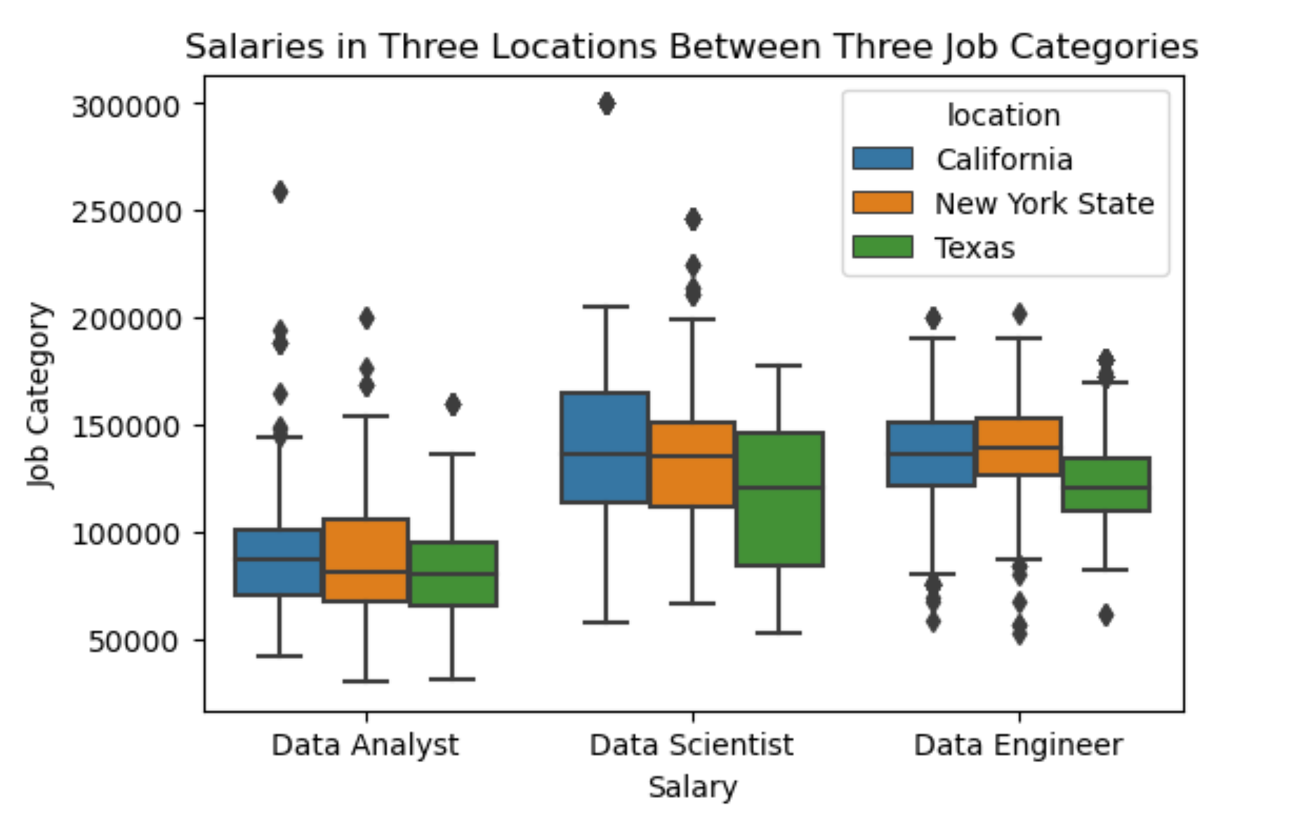
Job Market - Salary
DS & DE: High-Paid
DA & DS: Widely Distribution
DE: More Concentrated

Slide 8
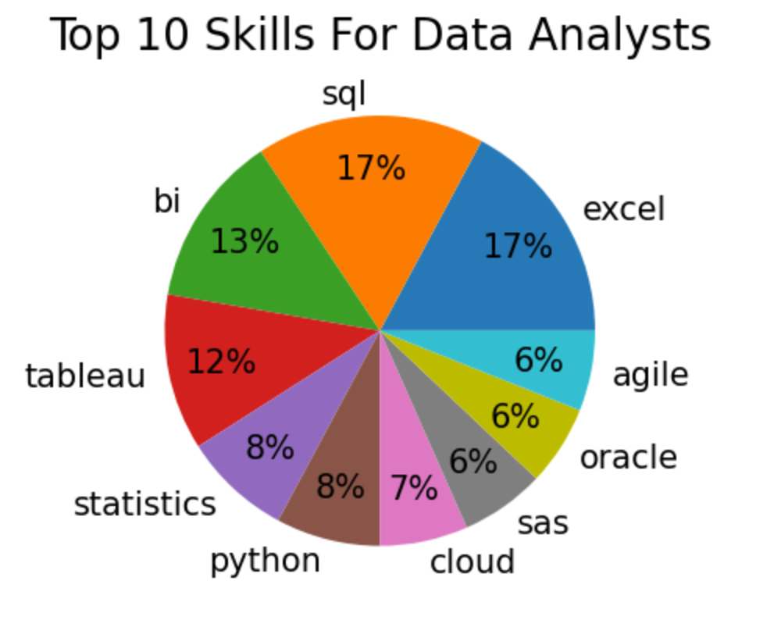
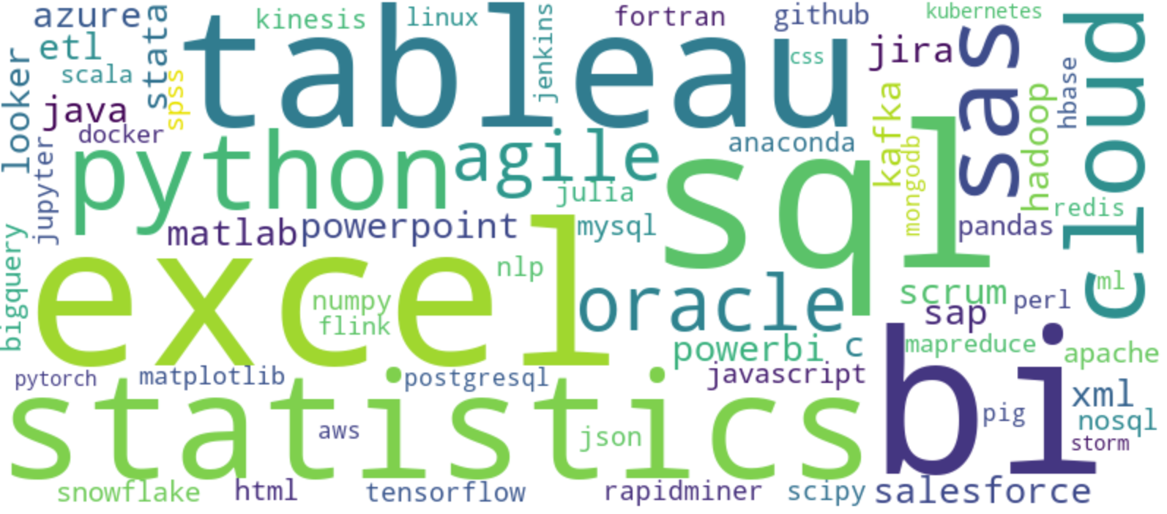
What need to do to prepare?
Tableau, Power BI, Excel
Data Visualization

Slide 9
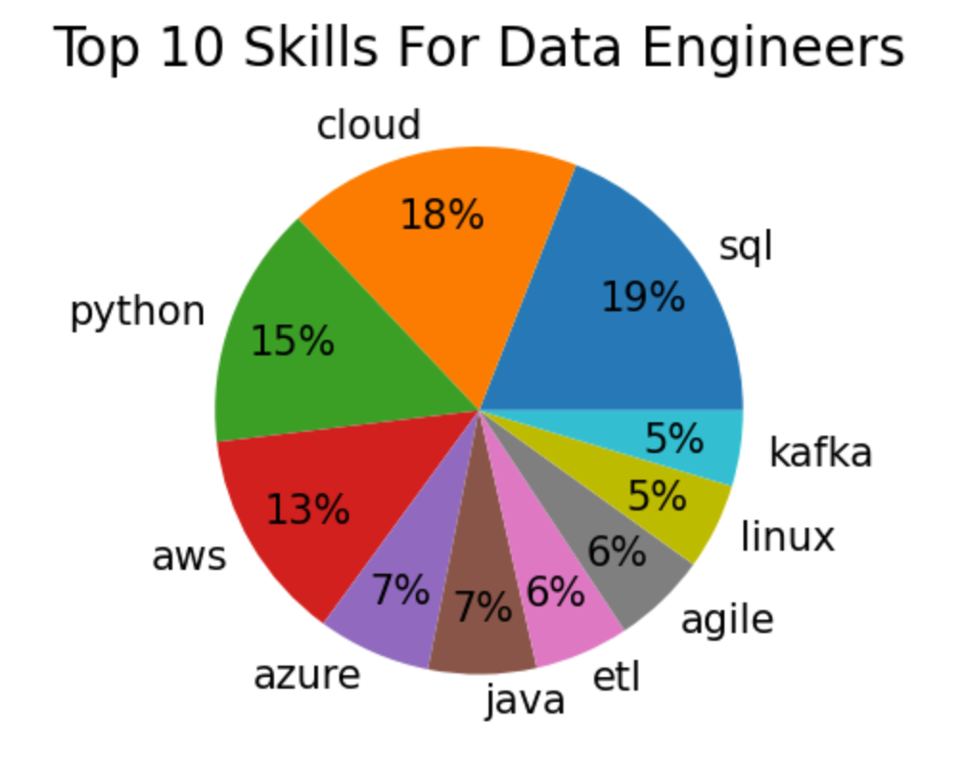

Data Engineer
Big Data
Cloud Computing
Software Development
AWS, Cloud, ETL, Spark, Hadoop, Kafka, Apache

Slide 10
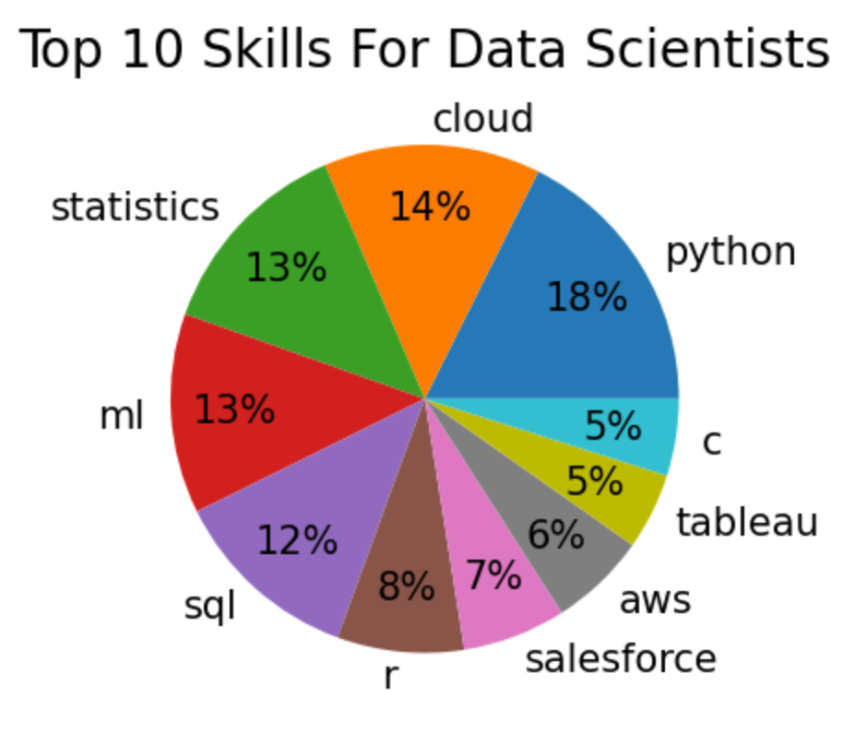

Data Scientists
Machine Learning
Deep Learning
Predictive Model
Cloud Computing
Statistics, ML, TensorFlow, Pytorch, R

Slide 11





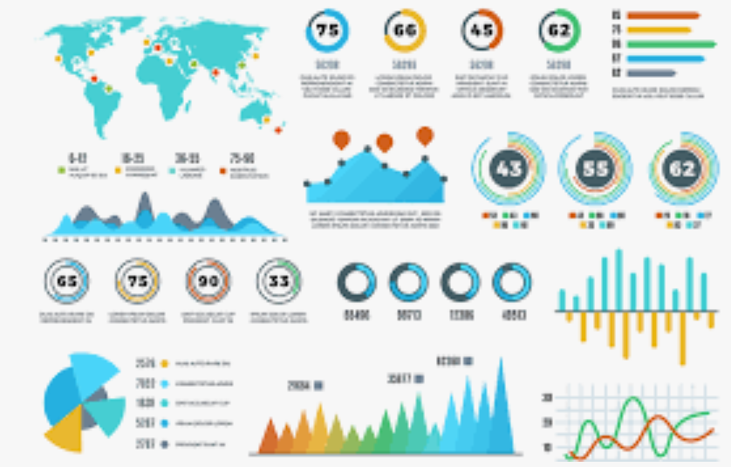








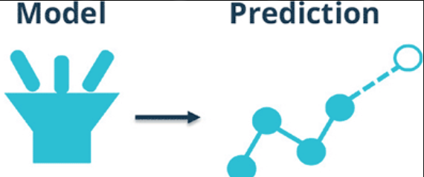
What is Data Analyst, Data Scientist and Data Engineer?
Data Scientist
Product Manager
Business-oriented
Software Development
Data Analyst
Product
operation
Data
Data Engineer
predictive

Slide 12
Limitation /Potential Extension
Limitations:
1. Searching result involves much more than the title we input.
2. Soft skills are ignored but crucial.
3. Only 30 days, without changes in time trends.
Extensions:
1. Explore more in the wide time range in the future.
2. Provide practical advice for Economics student

Slide 13
Thank You for Your Time !
Q & A

